Slide 1


Magnetic Force on Current
2025/08/05

Slide 2


CONTENTS
01
What Is Magnetic Force?
02
Deriving Wire Force
03
Max & Min Force
04
Length Matters
x
05
Everyday Examples

Slide 3

01
What Is Magnetic Force?

Slide 4

Force on a Moving Charge
A single charge drifting inside a wire feels a sideways push when it crosses magnetic field lines. This is the fundamental origin of the magnetic force on a current-carrying wire.
The Basic Force
No Motion, No Force
From Micro to Macro
A charge `q` moving with velocity `v` in a magnetic field `B` experiences a force `F = qvBsinθ`.
If the charge is stationary (`v=0`), the magnetic force is zero. Force only acts on moving charges .
A current is many charges moving together. Their individual forces add up, creating a net force on the wire itself.

Slide 5
02
Deriving Wire Force

Slide 6
From qv to IL: The Formula
We can derive a practical formula by considering the total charge moving through a wire segment. Replacing `qv` with `It` and summing charges (`nAL`) gives us the macroscopic force.
The Formula
F = Force on the wire (N)
B = Magnetic Field Strength (T)
I = Current (A)
L = Length of wire in field (m)
θ = Angle between B and I
The force is maximum when `B` is perpendicular to the current. The direction is given by the right-hand palm rule .

Slide 7
03
Max & Min Force

Slide 8
When Force Peaks or Vanishes
The force depends on the angle `θ` between the magnetic field and the current. It follows a sine curve, peaking at 90° and vanishing at 0° and 180°.
Zero Force
Maximum Force
Reversing Direction
`θ = 0°` or `180°`
`θ = 90°`
`θ > 180°`
`sin(0°) = sin(180°) = 0`
`sin(90°) = 1`
`sin(θ)` becomes negative.
Wire is parallel to the field.
Wire is perpendicular to the field.
Force direction reverses.

Slide 9
04
Length Matters

Slide 10
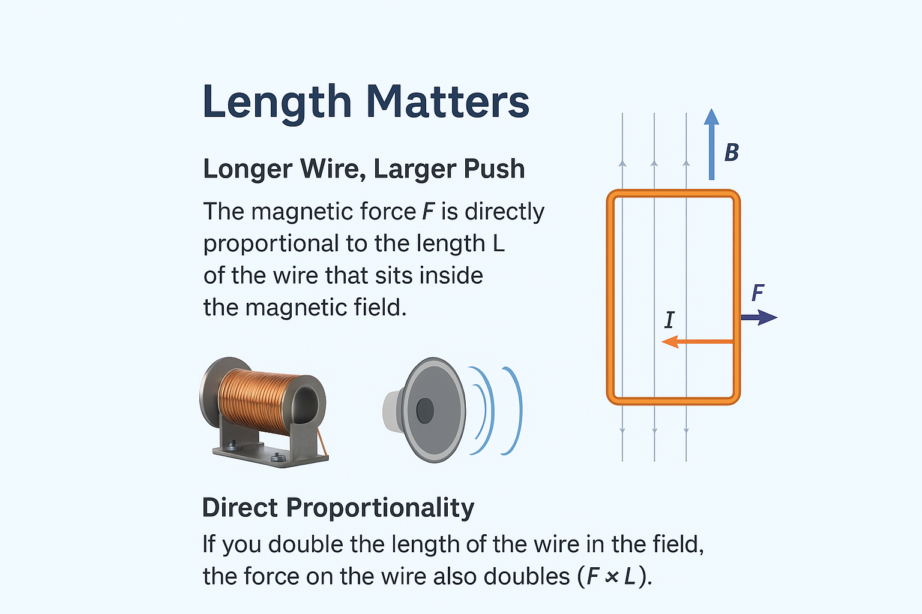
Longer Wire, Larger Push
The magnetic force `F` is directly proportional to the length `L` of the wire that sits inside the magnetic field.
Direct Proportionality
If you double the length of the wire in the field, the force on the wire also doubles (`F ∝ L`).
Effective Length
Only the portion of the wire within the magnetic field contributes to the force.
The Power of Coils
Coiling the wire increases the effective length within a compact space, a key principle in loudspeakers and motor windings .

Slide 11
05
Everyday Examples

Slide 12
Everyday Applications
The magnetic force on a current is the principle behind countless devices we use daily. Here are three key examples:
Electric Motors
Analog Meters
MagLev Trains
Opposite forces on either side of a coil create a rotating torque , spinning the armature.
The force on a coil is proportional to current, causing a needle deflection that measures it.
Powerful magnets lift the train by generating an upward force that balances gravity , eliminating friction.

Slide 13
06
Wrap-Up & Video

Slide 14
Key Takeaways & Further Viewing
Summary
Deeper Understanding
The force on a current-carrying wire is F = BIL sin θ.
Force is maximum when the wire is perpendicular to the field (θ = 90°).
For a fantastic visual summary and slow-motion confirmation of these concepts, watch this 4-minute animation:
Force is zero when the wire is parallel to the field (θ = 0°).
Reversing the current or the field reverses the direction of the force.
https://youtu.be/gnpa9Hadk_A

Slide 15

Thank you.
Kimi AI
2025/08/05

